Slide 1
IndAIGenious - Gen AI Powered Smart Manufacturing Assistant
Version 1.7

Slide 2
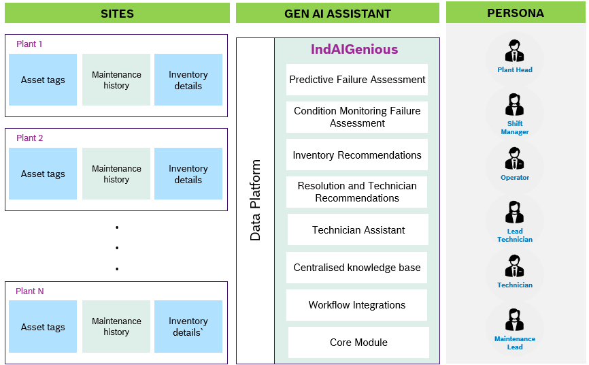
IndAIGenious
Functional View - Multi-Site Scenario
Issue To Resolution Flow
Failure
Trigger
Failure Assessment
Centralized Knowledge Base
Resolution and Technician Recommendations
Inventory Recommendations
Technician Assistant
Workflow Integrations
IndAIGenious Application Interface
1

Slide 3
MVP Roadmap for IndAIGenious
Key Milestones
MVP – 01 & 02 development - 2025
MVP – 03 development - 2026
M1 | M2 | M3 | M4 | M5 | M6 | M7 | M8 | M9 | M10 | M11 | M12 | M13 | M14 | M15 | M16 | M17
 |  |  |  |  |  |  | z
Base Module Development
RBAC Multimodal conversations UI/UX Session Management Multichannel support Multilingual Conversation SSO Integration (AD) Persona based Personalization
Persona based personalization
MVP01 Development
Centralized knowledge base
Resolution and technician recommendation
Condition Monitoring Failure Assessment
Technician Assistant -1/2
MVP02 Development
Technician Assistant – 2/2
Predictive failure assessment – 1/2
Inventory recommendation – 1/2
Infra Setup
Integration & Deployment
Module Prototypes
Base Module
Centralized knowledge base
Resolution and technician recommendation
Technician Assistant
Predictive failure assessment
Condition monitoring of critical assets
Inventory recommendations
Workflow Integrations
MVP03 Development
Predictive failure assessment – 2/2
Inventory recommendation – 2/2
Workflow integrations
Integration & Deployment
Integration & Deployment
Support & Maintenance

Slide 4
IndAIGenious – Functional Flow
BYOM: Bring Your Own Model
CM: Condition Monitoring
MT: Manual Trigger (On Breakdown Push Notification)
Functional Flow of IndAIGenious Modules
BYOM
CM (BYOM)
Predictive Maintenance
Condition Monitoring
4
Resolution and technician recommendation
Predictive Failure Assessment
3
Condition Monitoring Failure Assessment
2
Inventory recommendations
Workflow Integrations
5
7
6
Technician Assistant
Entry Modules (Failure & Impact Assessment/Q&A)
Recommendation Modules
Guidance Module
Outbound Integration Module
2
3
4
5
6
7
1

Slide 5
IndAIGenious – Module level details
Module 0: Core Module Diagram
Core Module
User Interaction
UI Based Self-Service
Log Management
Security
Deployment & Subscription Management
Responsible AI
Multimodal
User Management
Session Logs
SSO
Deployment – On Click
Responsible AI
Centralized Knowledge Base
Centralized Knowledge Base
Centralized Knowledge Base
Centralized Knowledge Base
Centralized Knowledge Base
Centralized Knowledge Base
Multilingual
Metadata Management
User Interaction Logs
Deployment – Updates
Multichannel
Persona Management
Metadata Change Logs
Subscriptions
Personalization
Agent Configuration
Log Monitoring
Session Management
Asset Onboarding
1

Slide 6


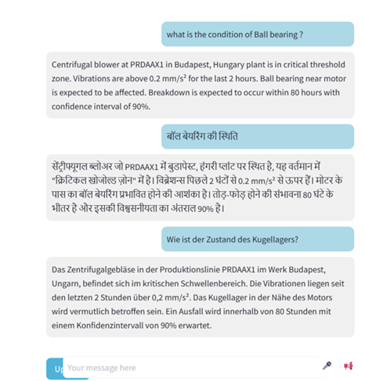
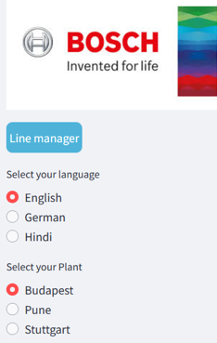
IndAIGenious – Module level details
Module 0: Core Module
Technician
Lead Technician
Operator
Shift Manager
Plant Head
Maintenance Lead
Description: The core module serves as the foundation of the IndAIGenious platform, enabling seamless, intuitive interactions across various channels while ensuring secure and personalized experiences for all users
Issue To Resolution Flow
Illustrative Representation
Failure
Trigger
Key Features
Multimodal conversations (Text, Voice, Image)
Multilingual conversations
Multi channel support (Web, Mobile)
Persona based Personalization
Session management
Condition Monitoring Failure Assessment
Centralized Knowledge Base
Resolution and Technician Recommendation
Inventory Recommendations
Impact
Eases accessibility
Ensures security
Delivers personalized experiences
Technician Assistant
Workflow Integrations
IndAIGenious Application Interface
1

Slide 7
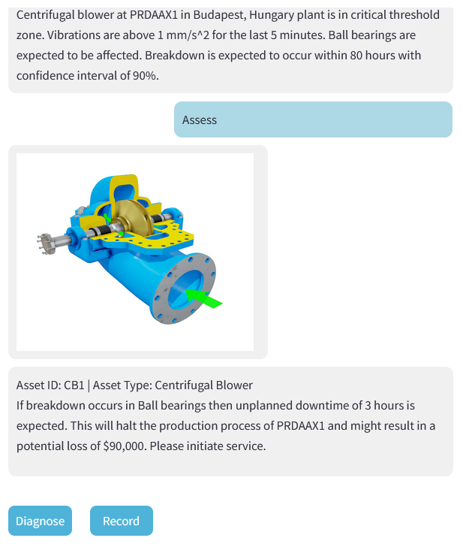
IndAIGenious – Module level details
Module 1: Predictive Failure Assessment
Technician
Lead Technician
Operator
Shift Manager
Plant Head
Maintenance Lead
Description: Proactively assesses each critical asset to predict potential faults or estimate Remaining Useful Life (RUL) using a Bring Your Own Model (BYOM) approach. Utilizes estimated time-to-failure data to recommend preventive actions
Issue To Resolution Flow
Illustrative Representation
BYOM
Predictive
Key Features
Potential failure prediction assessment
Fault prediction / RUL estimation for each asset based on BYOM
Highlights components at risk of failure with relevant images/links
Assistance in Root Cause Analysis (RCA)
Indicative cost impact due to potential downtime
Alerts for proactive maintenance and early warnings for equipment needing attention
Predictive Failure Assessment
Centralized Knowledge Base
Resolution and Technician Recommendation
Inventory Recommendations
Impact
Plug and play with your own predictive model
Early warning and proactive assessment support
RCA support
Cost savings
Technician Assistant
Workflow Integrations
IndAIGenious Application Interface
1

Slide 8
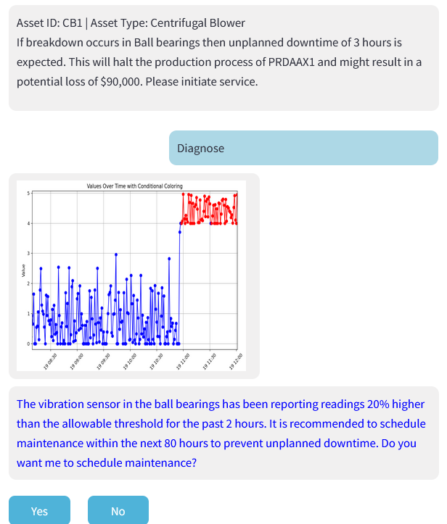
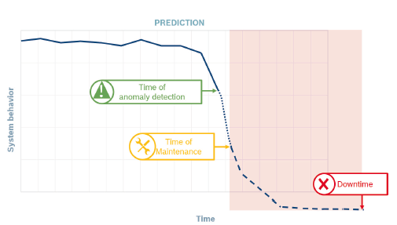
IndAIGenious – Module level details
Module 2: Condition Monitoring Failure Assessment
Technician
Lead Technician
Operator
Shift Manager
Plant Head
Maintenance Lead
Description: Continuously monitors asset health through appropriate data points. Helps to identify potential problems before critical assets fail, minimizing unplanned downtime and maximizing asset lifespan
Issue To Resolution Flow
Illustrative Representation
BYOM
Near Real-Time
Key Features
Monitoring of critical assets based on pre-defined rules/thresholds supporting BYOM
Indicative cost impact due to potential downtime
Highlights components of failure with relevant images/links
Assistance in Root Cause Analysis (RCA)
Condition Monitoring Failure Assessment
Centralized Knowledge Base
Resolution and Technician Recommendation
Inventory Recommendations
Impact
Early warning
RCA support
Cost savings
Technician Assistant
Workflow Integrations
IndAIGenious Application Interface
1

Slide 9
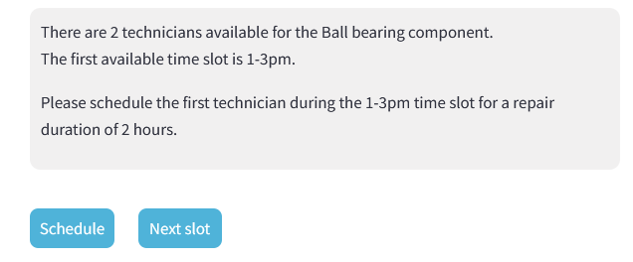
IndAIGenious – Module level details
Module 3: Resolution and Technician Recommendations
Technician
Lead Technician
Operator
Shift Manager
Plant Head
Maintenance Lead
Description: Offers tailored recommendations for repair and maintenance tasks and assigns the best-fit technician based on skill and availability
Issue To Resolution Flow
Illustrative Representation
Failure
Trigger
Key Features
AI-driven resolution recommendations
Best-fit technician recommendation based on expertise and proximity
Feedback loop for post-resolution logging for continuous learning
Failure Assessment
Centralized Knowledge Base
Resolution and Technician Recommendation
Inventory Recommendations
Impact
Reduction in unplanned downtime
Increases first-time fix rates
Optimizes workforce allocation
Technician Assistant
Workflow Integrations
IndAIGenious Application Interface
1

Slide 10
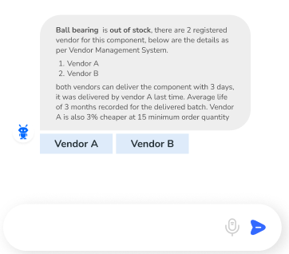
IndAIGenious – Module level details
Module 4: Inventory Recommendations
Technician
Lead Technician
Operator
Shift Manager
Plant Head
Maintenance Lead
Description: Provides intelligent inventory recommendations to ensure the optimal safety stock figures, reduce procurement lead time and production lead time due to missing parts
Issue To Resolution Flow
Illustrative Representation
Failure
Trigger
Key Features
Automated forecasting of parts based on asset health and usage patterns
Integration with ERP systems for stock and order management
Vendor recommendations for reducing procurement lead time
Alerts for critical part shortages or aging stock
Failure Assessment
Centralized Knowledge Base
Resolution and Technician Recommendation
Inventory Recommendations
Impact
Reduces inventory carrying costs
Reduces procurement lead time of essential parts during maintenance
Reduces production lead time caused by stockouts
Avoids back orders improving vendor relations
Technician Assistant
Workflow Integrations
IndAIGenious Application Interface
1

Slide 11
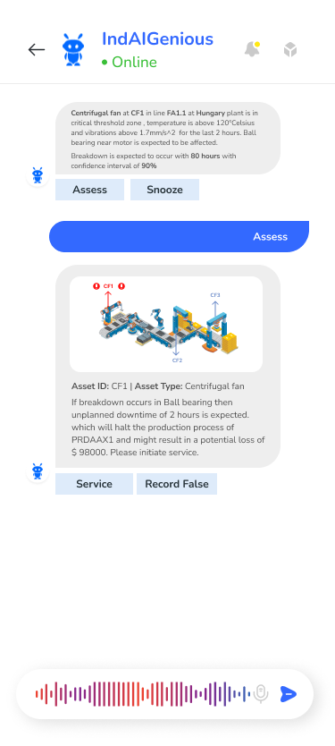
IndAIGenious – Module level details
Module 5: Technician Assistant
Technician
Lead Technician
Operator
Shift Manager
Plant Head
Maintenance Lead
Description: An on-the-go assistant that supports technicians with step-by-step repair instructions, guided troubleshooting, and real-time collaboration
Issue To Resolution Flow
Illustrative Representation
Failure
Trigger
Key Features
Multi-channel interface for accessing repair guides
Media support for complex tasks
On-demand access to manuals, diagrams, and SoPs
Health and safety recommendations based on OEM
Ergonomics recommendation for technician on job
Failure Assessment
Centralized Knowledge Base
Resolution and Technician Recommendation
Inventory Recommendations
Impact
Equips technicians with the utilities to solve problems efficiently
Enables technicians of varying experience levels to handle critical tasks, reducing dependency on few highly skilled staff
Boosts technician productivity and confidence
Technician Assistant
Workflow Integrations
IndAIGenious Application Interface
1

Slide 12
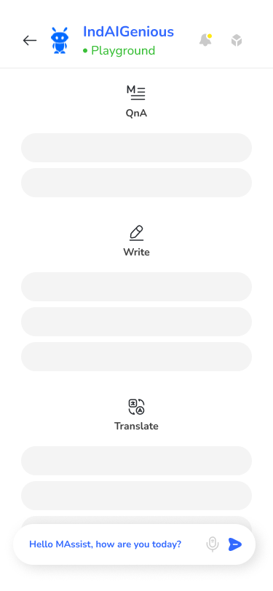
IndAIGenious – Module level details
Module 6: Centralized knowledge base
Technician
Lead Technician
Operator
Shift Manager
Plant Head
Maintenance Lead
Description: A unified, interactive platform serving as a dynamic playground, allowing users to query data anytime, compare critical KPIs across plants or sites, and foster cross-learning through shared insights and best practices
Issue To Resolution Flow
Illustrative Representation
Failure
Trigger
Key Features
Searchable library of manuals, procedures, and past resolutions across plants
Gen AI powered playground to directly search information within the knowledge base
Central platform for comparing critical KPIs across plants
User-contributed content with review workflows for continuous cross-learning among plants
Failure Assessment
Centralized Knowledge Base
Resolution and Technician Recommendations
Inventory Recommendations
Impact
Breaks down silos and democratizes access to knowledge
Reduces learning curves for new employees
Single source of truth for Gen AI workloads
Technician Assistant
Workflow Integrations
IndAIGenious Application Interface
1

Slide 13
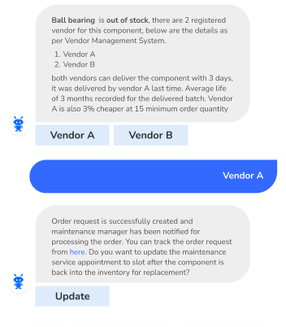
IndAIGenious – Module level details
Module 7: Workflow Integrations
Technician
Lead Technician
Operator
Shift Manager
Plant Head
Maintenance Lead
Description: Integrates seamlessly with existing plant systems and third-party tools to streamline workflows, enabling and simplifying necessary actions based on recommendations and enhance productivity across all systems in maintenance function
Issue To Resolution Flow
Illustrative Representation
Failure
Trigger
Key Features
Compatibility with ERP, MES, and CMMS systems
APIs based custom integrations
Automated data synchronization across platforms
Condition Monitoring Failure Assessment
Centralized Knowledge Base
Resolution and Technician Recommendation
Inventory Recommendations
Impact
Improves coordination across teams and systems
Boosts overall productivity by streamlining operations
Technician Assistant
Workflow Integrations
IndAIGenious Application Interface
1

Slide 14
MVP Roadmap for IndAIGenious
Key Milestones
MVP – 01 & 02 development - 2025
MVP – 03 development - 2026
M1 | M2 | M3 | M4 | M5 | M6 | M7 | M8 | M9 | M10 | M11 | M12 | M13 | M14 | M15 | M16 | M17
 |  |  |  |  |  |  | z
Base Module Development
RBAC Multimodal conversations UI/UX Session Management Multichannel support Multilingual Conversation SSO Integration (AD) Persona based Personalization
Persona based personalization
MVP01 Development
Centralized knowledge base
Resolution and technician recommendation
Technician Assistant -1/2
MVP02 Development
Technician Assistant – 2/2
Critical asset failure assessment – 1/2
Condition monitoring of critical assets – 1/2
Inventory recommendation – 1/2
Infra Setup
Integration & Deployment
Module Prototypes
Base Module
Centralized knowledge base
Resolution and technician recommendation
Technician Assistant
Critical asset failure assessment
Condition monitoring of critical assets
Inventory recommendations
Workflow Integrations
MVP03 Development
Critical asset failure assessment – 2/2
Condition monitoring of critical assets – 2/2
Inventory recommendation – 2/2
Workflow integrations
Integration & Deployment
Integration & Deployment
Support & Maintenance

Slide 15
Pricing strategy for IndAIGenious
Tier based pricing
Basic Plan
Annual License Fees: $15000
Standard Plan
Annual License Fees: $35000
Enterprise Plan
Annual License Fees: $50000
Modules:
Base Module
Centralized knowledge base
Role Based Access Control
Cloud Agnostic
Language : English
Personas : 1
Standard users : 10
No of critical assets support : upto 25
Everything from Basic Plan
Modules: (Basic+)
Resolution and technician recommendation
Technician Assistant
Inventory recommendation
Language : English + 1
Personas : 4
Standard users : 25
No of critical assets support : upto 50
Everything from Standard Plan
Modules: (Standard+)
Critical asset failure assessment
Condition monitoring of critical assets
Workflow Integrations
Language : English + Custom (upto 6)
Personas : Custom(upto 10)
Standard users : 50
No of critical assets support : upto 100
* Anything beyond Custom plan can be provided.

Slide 16
Centralized Knowledge Base
IndAIGenious – Functional Flow
BYOM: Bring Your Own Model
CM: Condition Monitoring
MT: Manual Trigger (On Breakdown Push Notification)
Functional Flow of IndAIGenious Modules
Maintenance
Analytics & AI
BYOM
CM
MT
Predictive
Centralized Knowledge Base
Entry Point
Real Time
On Demand
IndAIGenious
IndAIGenious Application Chat Interface Workflow
Centralized Knowledge Base
1
Predictive Failure Assessment
3
Condition Monitoring Failure Assessment
On Demand Failure Assessment
2
OD
Playground
Centralized Knowledge Base
Data Source
4
Resolution and technician recommendation
7
Workflow Integrations
Data Platform
Document Summarization
5
Inventory recommendations
6
Technician Assistant
Metadata Information
Entry Modules (Failure & Impact Assessment/Q&A)
Recommendation Modules
Guidance Module
Outbound Integration Module
2
3
OD
4
5
6
7
0
Cross-site Queries
Multimodal Conversations
Multilingual Conversations
Multichannel Support
Persona based Personalization
RBAC
Session Management
Core Module
1

